Slide 1
Computer Organization
TOPIC 2.0 – Computer organization
TOPIC 2
2.1.12-2.1.13: Truth Tables and Boolean Logic

Slide 2

REVIEW REVIEW REVIEW REVIEW REVIEW REVIEW
THE WARM-UP QUESTION
Construct a diagram depicting the logic gates for the expression below:
if (not condition1 or not condition2) and condition3

Slide 3
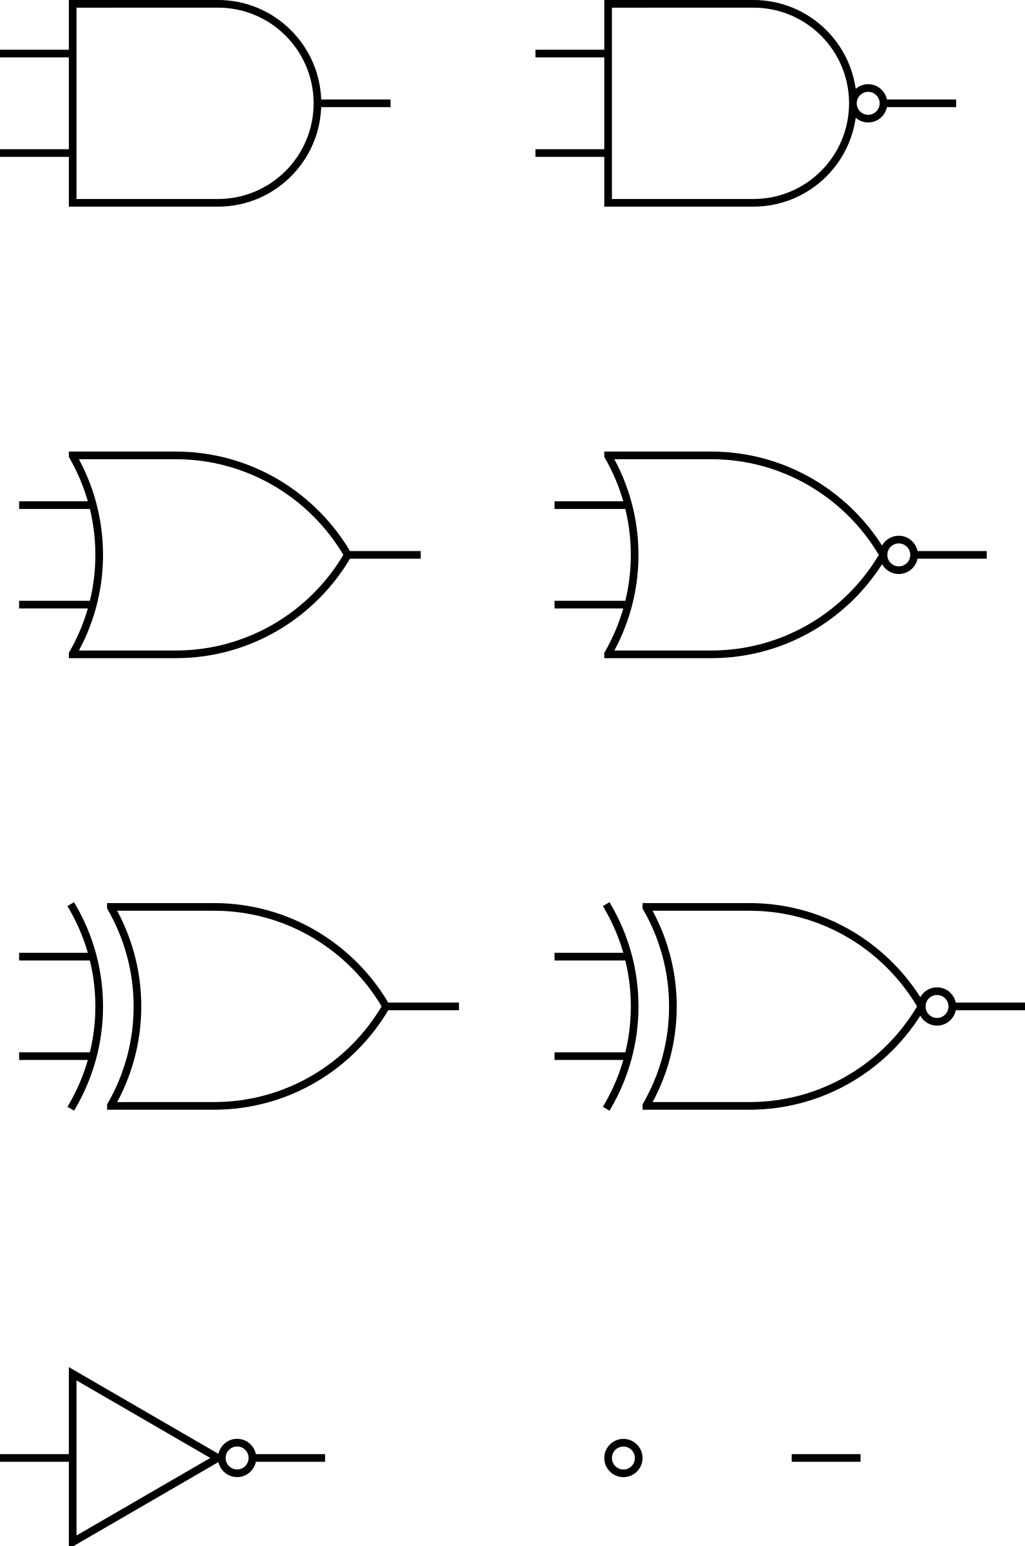
REVIEW REVIEW REVIEW REVIEW REVIEW REVIEW
THE WARM-UP ANSWER
z

Slide 4
TOPIC 2.1.12 – TRUTH TABLES
TRUTH TABLES
Using our basic Boolean operators…
What are our Boolean operators?
We can create tables that represent all possible inputs and outputs of a logic statement
We saw some of these last time
Which of our basic operations is this?
Inputs |  | Output
0 (false) | 0 (false) | 0 (false)
0 (false) | 1 (true) | 1 (true)
1 (true) | 0 (false) | 1 (true)
1 (true) | 1 (true) | 0 (false)

Slide 5

TOPIC 2.1.12 – TRUTH TABLES
Inputs |  | Output
F | F | F
F | T | T
T | F | T
T | T | F
Truth tables
Values can be represented as:
True, T, or 1
False, F, or 0
For the rest of this lesson, I’ll be using T and F
Inputs |  | Output
0 | 0 | 0
0 | 1 | 1
1 | 0 | 1
1 | 1 | 0
Inputs |  | Output
false | false | false
false | true | true
true | false | true
true | true | false

Slide 6
TOPIC 2.1.12 – TRUTH TABLES
TRUTH TABLES
Truth tables can have any number of input values
The number of rows on the table will be 2^{the number of input values}
This table with two values has 2² = 4 rows
Inputs |  | Output
0 (false) | 0 (false) | 0 (false)
0 (false) | 1 (true) | 1 (true)
1 (true) | 0 (false) | 1 (true)
1 (true) | 1 (true) | 0 (false)

Slide 7
TOPIC 2.1.12 – TRUTH TABLES
TRUTH TABLES
Let’s take the statement “If it is not cold and not raining, I will go outside”
Our three statements are “cold”, “rain”, and “go outside” in this case
Our input values are “cold” and “rain”
Our output value is “go outside”
We can also call these “propositions”
Inputs |  | Output
Cold | Rain | Will go outside
F | F | T
F | T | F
T | F | F
T | T | F

Slide 8
TOPIC 2.1.12 – TRUTH TABLES
TRUTH TABLES
Let’s break this out a little to make our path to output clearer
Inputs |  |  |  |  | Output
Cold | Rain | Not Cold | Not Rain | Not Cold AND Not Rain | Will go outside
F | F | T | T | T | T
F | T | T | F | F | F
T | F | F | T | F | F
T | T | F | F | F | F

Slide 9
TOPIC 2.1.12 – TRUTH TABLES
TRUTH TABLES
Let’s simplify our propositions
“It is raining outside” = p
“It is cold outside” = q
To negate our symbols, we use a ‘~’ in front of them (you may also use a line over the text)
To combine our propositions we use v for or, and ^ for and
Putting that all together…
~p ^ ~q
Inputs |  | Output
p | q | ~p ^ ~q
F | F | T
F | T | F
T | F | F
T | T | F

Slide 10
TOPIC 2.1.12 – TRUTH TABLES
TRUTH TABLES
Full circle with our broken out table
Inputs |  |  |  | Output
p | q | ~p | ~q | ~p ^ ~q
F | F | T | T | T
F | T | T | F | F
T | F | F | T | F
T | T | F | F | F

Slide 11
TOPIC 2.1.12 – TRUTH TABLES
TRUTH TABLES
Inputs |  |  | Output
p | q | r | ???
F | F | F
F | F | T
F | T | F
F | T | T
T | F | F
T | F | T
T | T | F
T | T | T
Let’s take the statement “A car is safe to drive if it has a seatbelt and the brakes are working, or if the airbags are working and the brakes are working.”
Our propositions are as follows:
The car has a seatbelt – p
The car’s brakes are working – q
The car’s airbags are working – r
The car is safe to drive - ???

Slide 12
TOPIC 2.1.12 – TRUTH TABLES
TRUTH TABLES
Inputs |  |  |  |  | Output
p | q | r | p^q | r^q | (p^q)v(r^q)
F | F | F | F | F
F | F | T | F | F
F | T | F | F | F
F | T | T | F | T
T | F | F | F | F
T | F | T | F | F
T | T | F | T | F
T | T | T | T | T

Slide 13
TOPIC 2.1.12 – TRUTH TABLES
TRUTH TABLES
Inputs |  |  |  |  | Output
p | q | r | p^q | r^q | (p^q)v(r^q)
F | F | F | F | F | F
F | F | T | F | F | F
F | T | F | F | F | F
F | T | T | F | T | T
T | F | F | F | F | F
T | F | T | F | F | F
T | T | F | T | F | T
T | T | T | T | T | T

Slide 14
TOPIC 2.1.12 – TRUTH TABLES
TRUTH TABLES
Inputs |  |  | Output
p | q | r | ???
F | F | F
F | F | T
F | T | F
F | T | T
T | F | F
T | F | T
T | T | F
T | T | T
Let’s take the statement “You get a discount if you are a member and it is not a sale day, or if it is a sale day and you spend more than $50
Our propositions are as follows:
??? – p
??? – q
??? – r
??? - ???

Slide 15
TOPIC 2.1.12 – TRUTH TABLES
TRUTH TABLES
Inputs |  |  |  |  | Output
p | q | r | p^~q | q^r | (p^~q)v(q^r)
F | F | F | F | F
F | F | T | F | F
F | T | F | F | F
F | T | T | F | T
T | F | F | T | F
T | F | T | T | F
T | T | F | F | F
T | T | T | F | T

Slide 16
TOPIC 2.1.12 – TRUTH TABLES
TRUTH TABLES
Inputs |  |  |  |  | Output
p | q | r | p^~q | q^r | (p^~q)v(q^r)
F | F | F | F | F | F
F | F | T | F | F | F
F | T | F | F | F | F
F | T | T | F | T | T
T | F | F | T | F | T
T | F | T | T | F | T
T | T | F | F | F | F
T | T | T | F | T | T

Slide 17
TOPIC 2.1.12 – Simplification
Simplification (Boolean algebra)
We have a few rules that help us to simplify Boolean expressions
Annulment Law:
p ^ F = F
p v T = T
Identity Law:
p ^ T = p
p v F = p
Idempotent Law:
p ^ p = p
p v p = p

Slide 18
TOPIC 2.1.12 – Simplification
Simplification (Boolean algebra)
Complement Law:
p ^ ~p = F
p v ~p = T
Commutative Law:
p ^ q = q ^ p
p v q = q v p
Associative Law:
p ^ (q ^ r) = (p ^ q) ^ r
p v (q v r) = (p v q) v r

Slide 19
TOPIC 2.1.12 – Simplification
Simplification (Boolean algebra)
Distributive Law:
p ^ (q v r) = (p ^ q ) v (p ^ r)
p v (q ^ r) = (p v q ) ^ (p v r)
Absorption Law:
p ^ (p v q) = p
p v (p ^ q) = p
Involution (Double Negative) Law:
~(~p) = p
DeMorgan’s Law:
(p v q) ^ r = (p ^ r) v (q ^ r)
(p ^ q) ^ r = (p ^ r) ^ (q ^ r)

Slide 20
TOPIC 2.1.12 – Simplification
Simplification practice
Simplify the following expressions using Boolean laws
p v (p ^ q)
(p v q) ^ (p v ~q)
~(p ^ q) v (p ^ q)

Slide 21

TOPIC 2.0 – computer organization
Vocab to remember
Proposition
Truth Table
Annulment Law
Identity Law
Idempotent Law
Complement Law
Commutative Law
Associative Law
Distributive Law
Absorption Law
Involution (Double Negative) Law
DeMorgan’s Law

